Slide 1
Chapter Three
Fundamentals of General, Organic and Biological Chemistry
7th Edition
Ionic Compounds
James E. Mayhugh
Copyright © 2010 Pearson Education, Inc.

Slide 2
3.1 Ions
By gaining or losing one or more electrons, an atom is converted into a charged atom called an ion.
Na⁺ means that a sodium atom has…
lost 1 electron
S²⁻ means that a sulfur atom has…
gained 2 electrons

Slide 3
3.1 Ions
Positive ions are also called cations
Negative ions are also called anions
(“cation” has a “t” which looks like “+”, so a cation is a positive ion)

Slide 4
THE BASIS OF MAIN GROUP CHEMICAL REACTIONS:
Atoms will gain, lose or share enough electrons to have the same number of electrons as the NEAREST noble gas.
(In number of electrons… not “distance” on the periodic table.)
Boron will lose 3 electrons rather than gain 5

Slide 5
THE BASIS OF MAIN GROUP CHEMICAL REACTIONS:
This leaves atoms with a full outer shell…
With an outer electron configuration of…?
ns²np⁶
(or 2s² if it ends up with helium’s e⁻ config.)

Slide 6
THE BASIS OF MAIN GROUP CHEMICAL REACTIONS:
Stated another way:
The Octet rule: Main group elements tend to undergo reactions that leave them with the maximum of 8 valence electrons.
noble gases have a full valence shell of 8 electrons
(except Helium, which has a full valence shell of 2 valence electrons)

Slide 7
3.2 Ion Formation
**In this chapter, we will only deal with reactions where atoms gain or lose electrons to obtain their “octet”.

Slide 8
The symbol of an aluminum ion would be ____, and it is _______________.
Al³⁺, an anion
Al³⁺, a cation
Al^{3–}, an anion
Al^{3–}, a cation

Slide 9
3.1 More Examples
What ion will each of the following form when it reacts with another atom?
Magnesium
Bromine
Phosphorus
Potassium

Slide 10
3.2 Periodic Properties Of Elements
Some atom properties that change predictably on the periodic table :
Sizes of atoms
How readily atoms lose electrons
How readily atoms gain electrons

Slide 11
All three of those properties depend on how strongly attracted an atom’s valence electrons are to its positive nucleus.
The amount of nucleus / valence electron attraction depends on 2 factors:
In order of priority:

Slide 12
First Priority:
The energy level the valence electrons are in
The smaller the energy level…
The closer the electrons are to the + nucleus…
the more tightly bound the electrons are to its nucleus
But what if the atoms we’re comparing are in the same row and therefore are in the same valence shell?

Slide 13
Second Priority (ONLY for atoms with valence electrons in the same shell)
How many protons there are
The more protons, the more tightly the electrons are attracted by the nucleus.

Slide 14
3.2 Definitions of the 3 Atom Properties
Atom Size (Atomic Radius): The distance from the nucleus to the outer edge of the outermost electron orbital
Ionization energy: The energy required to remove one electron from a single atom
Electron affinity: The ability that an atom has for “stealing” an electron from another atom and adding it to its valence shell.

Slide 15
3.2 The Periodic TRENDS: Sizes of Atoms
Across a period:
Atoms get smaller!!
As you go ACROSS a period:
Electrons become more and more attracted to the nucleus because the next atom has one more proton in its nucleus

Slide 16
3.2 The Periodic TRENDS: Sizes of Atoms
Down a group:
Atoms get larger
As you go down a group:
The valence shell increases by 1 for each row, and orbitals in higher energy levels are larger than those in lower levels.

Slide 17
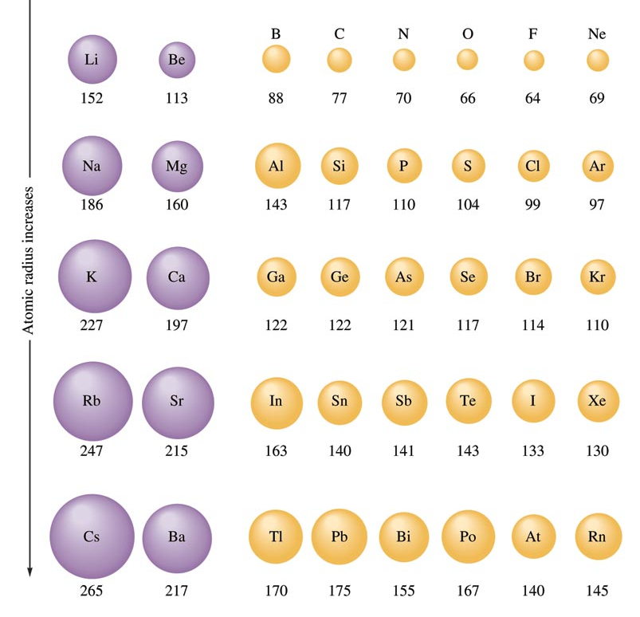
Atomic Radii for Selected Atoms

Slide 18
3.2 The Periodic TRENDS: Ionization Energy
Across a period:
It takes MORE energy to remove a
valence electron (I.E. gets greater)
As you go ACROSS a period:
Electrons become more and more attracted to the nucleus because the next atom has one more proton in its nucleus, so they are harder to pull off.

Slide 19
3.2 The Periodic TRENDS: Ionization Energy
Down a group:
It takes LESS energy to remove a valence electron (I.E. gets lower)
As you go down a group:
The valence shell increases by 1 for each row, so the valence electrons are FARTHER AWAY from the nucleus each row you go down.
Opposite charges do not attract as well at greater distances, making it easier to remove electrons.

Slide 20
3.2 The Periodic TRENDS: Ionization Energy
Summary:
Ionization energy increases as you go up and/or to the right on the periodic table.

Slide 21
Using only the periodic table, determine which element below loses an electron most easily?
Cl
Li
Na
S

Slide 22
3.2 The Periodic TRENDS: Electron Affinity
Across a period:
Atoms have a greater attraction for
another electron. (E.A. Increases)
As you go ACROSS a period:
More protons as you go across, so it becomes easier for a nucleus to attract a new electron

Slide 23
3.2 The Periodic TRENDS: Electron Affinity
Down a group:
Atoms have a lesser attraction for another electron. (E.A. Decreases)
As you go down a group:
the valence shells get FARTHER AWAY from the nucleus, making it harder for the nucleus to attract new electrons.

Slide 24
3.2 The Periodic TRENDS: Electron Affinity
Summary:
Electron Affinity (the ability for an atom to gain an EXTRA electron) will increase as you go up and/or to the right on the periodic table

Slide 25
3.2 The Periodic TRENDS: Special Case: Noble Gases
The noble gases neither gain nor lose an electron easily.
They have high IE values
and low EA values (which is an exception to the normal trend).
These elements tend to not make chemical bonds AT ALL!

Slide 26
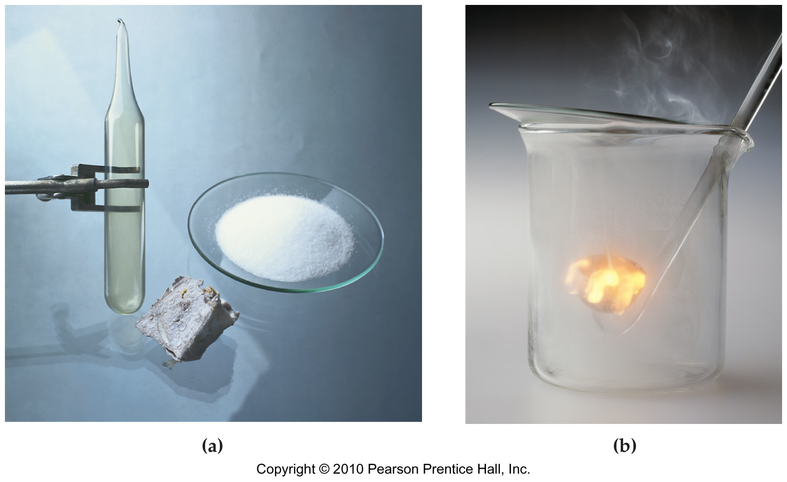
3.3 & 3.5 Ionic Bonding
When sodium metal reacts with chlorine gas crystals of sodium chloride or table salt are formed.

Slide 27
Let’s look at how sodium reacts with chlorine:

Slide 28
Let’s look at how sodium reacts with chlorine:

Slide 29
Let’s look at how sodium reacts with chlorine:
+
-

Slide 30
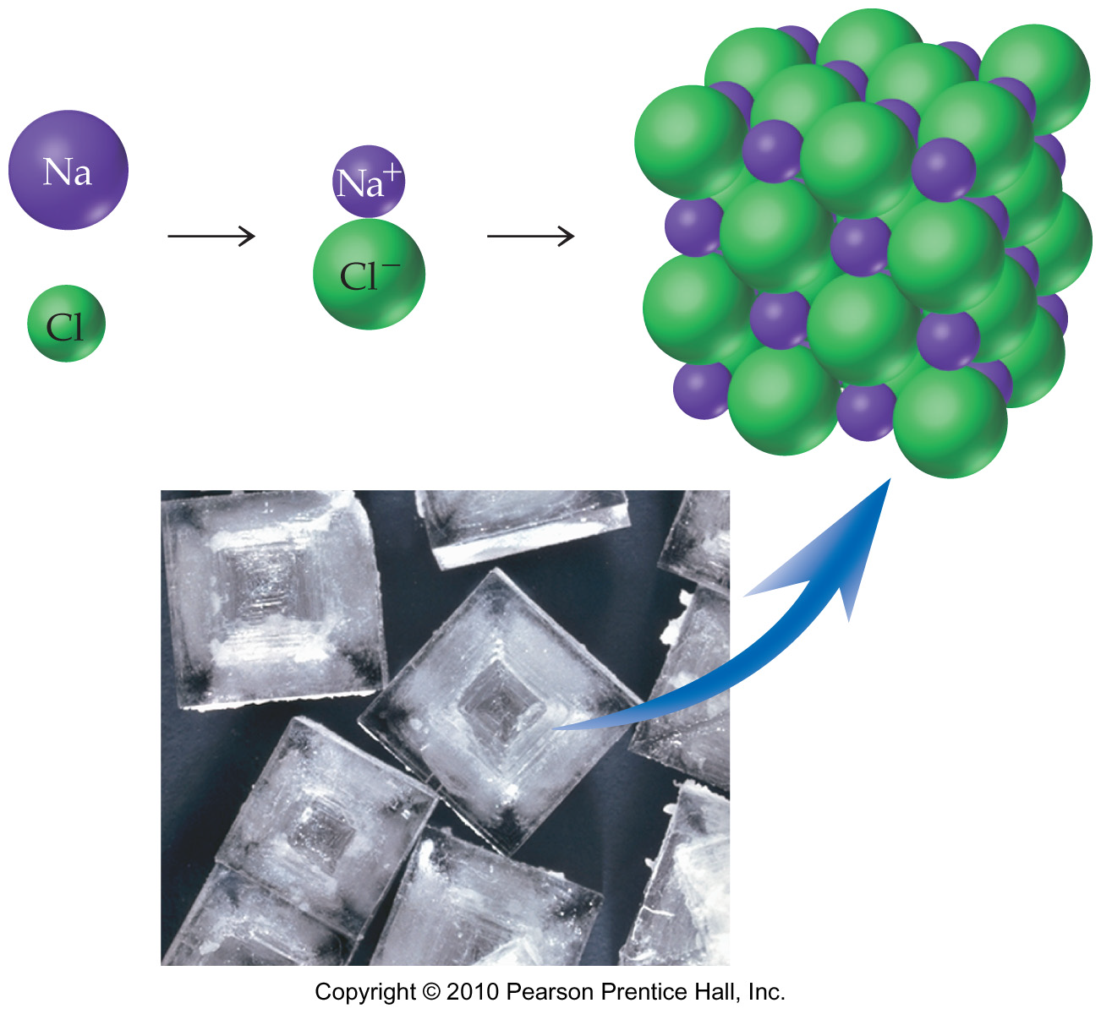
Na⁺ and Cl⁻ ions in a sodium chloride crystal.

Slide 31
SUMMARY
A sodium atom transfers an electron to a chlorine atom forming Na⁺ and Cl⁻ ions.
The opposite electrical charges attract each other… that attraction is called an ionic bond
Ionic compound: A compound that contains ionic bonds.

Slide 32
IMPORTANT NOTE: Ionic bonding only works when one atom loses electrons well and the other atom gains electrons well.
Metals: LOSE electrons well
Non-metals: GAIN electrons when bonding (sometimes by sharing)
SO…. Ionic bonding generally occurs between a metal atom and a non-metal atom
(or a metal and a non-metal “grouping”)

Slide 33
3.4 Some Properties of Ionic Compounds
Ionic compounds are always solid at room temperature.
Once an ionic solid is dissolved in water, the ions can move freely and conduct electricity.
Very high melting and boiling points
(Sodium chloride melts at 801ºC and boils at 1413ºC.)

Slide 34
Ionic solids are brittle and will shatter if struck sharply.
Many (but not all) ionic compounds are soluble in water.

Slide 35
3.9 Formulas of Ionic Compounds
Ionic compounds are neutrally charged.
A chemical formula shows the lowest whole number ratio of anions and cations required for a total charge of zero for the compound.

Slide 36
3.9 Formulas of Ionic Compounds
Example: what is the chemical formula of magnesium chloride?
Step 1: use their placement on the periodic table to determine their charges and write the symbols of the two ions
Mg²⁺ Cl⁻
Step 2: Combine the minimum # of each to have the total charge balance out to zero
MgCl₂
(No charges are to be shown in final answer)

Slide 37
Formulas of Ionic Compounds
Example: what is the chemical formula of aluminum oxide?
Al₂O₃

Slide 38
3.6 Charges of Monatomic Cations
A few metals form cations of only one charge
MOST metals form cations of variable charges.
☹
It is IMPERITIVE that you MEMORIZE which metals form ions with only one possible charge
That way, by default, ALL OTHER METALS can form various ions of different charges.

Slide 39
Cations with variable charges:
The name of the metal with its CURRENT charge written as a Roman Numeral in parentheses after the metal’s name
Fe³⁺ is the iron (III) ion.
HW #68: “ferric ion” is actually iron(III)
HW #69: “chromous ion” is chromium(II)

Slide 40
3.6 Charges of Cations to MEMORIZE
Metal cations that have only ONE charge:
Group 1 metals are ALWAYS 1+
Group 2 metals are ALWAYS 2+
Aluminum is ALWAYS 3+
Zinc is ALWAYS 2+
Cadmium is ALWAYS 2+
These cations NEVER get a Roman Numeral!!

Slide 41
Charges of Monatomic Cations
That’s 15 metals out of about 93…
the rest are all assumed to have variable charges (more than one possible charge per metal)
Example: Iron can be Fe²⁺ or Fe³⁺
But calcium can ONLY be Ca²⁺

Slide 42
3.6 Charges of Monatomic Anions
These are easy…
Anions NEVER have variable charges, so there’s nothing to memorize ☺

Slide 43
3.7 Naming Monatomic Ions
Cations with only ONE charge:
The name of the element (or compound) with no adjustments
Mg²⁺ is the magnesium ion (as opposed to the “magnesium atom”)

Slide 44
Anions:
Monatomic anions: cut off the ending and add –ide.
O²⁻ is the oxide ion
P³⁻ is the phosphide ion
Cl⁻ is the chloride ion

Slide 45
3.8 Polyatomic Ions
Ions that are composed of more than one atom are called polyatomic ions.
Example: SO₄²⁻ is the sulfate ion.
The “2-” is the charge of the whole grouping of atoms.
DON’T change the endings of polyatomic ions… they’ve already been changed!

Slide 46
3.9 Formulas of Ionic Compounds: A Summary
List the cation first and the anion second; for example, NaCl not ClNa.
Make sure to reduce subscripts; for example,
MgO not Mg₂O₂… SnO₂ not Sn₂O₄
Do not write the charges of the ions; for example, KF not K+F⁻
Use parentheses around a polyatomic ion formula if it has a subscript; for example, Al₂(SO₄)₃ not Al₂SO₄₃.

Slide 47
3.10 Naming Ionic Compounds
Cation name then anion name
That’s it… seriously!

Slide 48
3.10 Naming Ionic Compounds
Some reminders, though:
Cations of metals with variable charges have a Roman Numeral in its name.
Cations of metals with only one charge are NOT to include a Roman Numeral… you will lose points if you do so.
Don’t forget to change the ending of any monatomic anions to –ide.

Slide 49
The name of the compound Cr₂(SO₄)₃ is
chromium sulfate.
chromium(II) sulfate.
chromium (III) sulfate.
dichromium trisulfate.

Slide 50
The name of the compound Cr₂(SO₄)₃ is
chromium sulfate.
chromium(II) sulfate.
chromium (III) sulfate.
dichromium trisulfate.

Slide 51
3.11 Identifying Acids and Bases
The formulas of acids start with “H”
Exception: water, by itself, is not acidic
examples: H₂SO₄ , HCl, HCH₃CO₂ , HNO₃
(note that acids aren’t _{(officially)} ionic… no metal atoms!)

Slide 52
Most bases are ionic compounds that contain OH⁻ (hydroxide)
Examples: NaOH Ca(OH)₂ Al(OH)₃

Slide 53
Of the compounds HNO₂, Ba(OH)₂, and HF, which are acids?
All are acids.
None is an acid.
Only Ba(OH)₂ is an acid.
Only HNO₂ and HF are acids.

Slide 54
Of the compounds HNO₂, Ba(OH)₂, and HF, which are acids?
All are acids.
None is an acid.
Only Ba(OH)₂ is an acid.
Only HNO₂ and HF are acids.

Slide 55
End of Chapter 3

Slide 56
Chapter Summary
Atoms are converted into cations by the loss of one or more electrons and into anions by the gain of one or more electrons.
Ionic compounds are composed of cations and anions held together by ionic bonds. Ionic compounds conduct electricity when dissolved in water, and they are generally crystalline solids with high melting points and high boiling points.
Main group elements tend to form ions in which they have gained or lost the appropriate number of electrons to reach a noble gas configuration.

Slide 57
Chapter Summary Contd.
Metals lose electrons more easily than nonmetals. As a result, metals usually form cations.
Nonmetals gain electrons more easily than metals. As a result, reactive nonmetals usually form anions.
The ionic charge can be predicted from the group number and the octet rule. For main group metals, the charge on the cation is equal to the group number. For nonmetals, the charge on the anion is equal to the group number-8.
Ionic compounds contain appropriate numbers of anions and cations to maintain overall neutrality.

Slide 58
Chapter Summary Contd.
Cations have the same name as the metal, monatomic anions have the name ending -ide.
For metals that form more than one ion, a Roman numeral equal to the charge is used to name the ion.
The cation name is given first, with the charge of the metal ion indicated if necessary, and the anion name is given second.
An acid is a substance that yields H⁺ ions when dissolved in water, and a base is a substance that yields OH⁻ ions when dissolved in water.

Slide 59
Key Words
Acid
Anion
Base
Cation
Electron affinity
Formula unit
Ion
Ionic bond
Ionic compound
Ionic solid
Ionization energy
Octet rule
Polyatomic ion

